Slide 1
The Battle of Neighborhoods
Analysis of Chinese restaurant in new York city

Slide 2
PROBLEMS
Tourist in 2021 from abroad significantly reduce because of COVID-19 Pandemic, hence the local tourist should be maximized to be improved. One of the solution is to open or re-open Restaurant. One of most favorite restaurant in U.S is Chinese Restaurant. In order to open the new restaurant, several factors should be considered such as:
Whether the location closely related to other Chinese Restaurant
Whether the location has the best chance to be opened
Other reasons

Slide 3
DATA
DATA
Data New York City is collected from https://cocl.us/new_york_dataset
Foursquare API is used to locate all venues and filtered with Chinese Restaurant
Data is visualize using Python

Slide 4
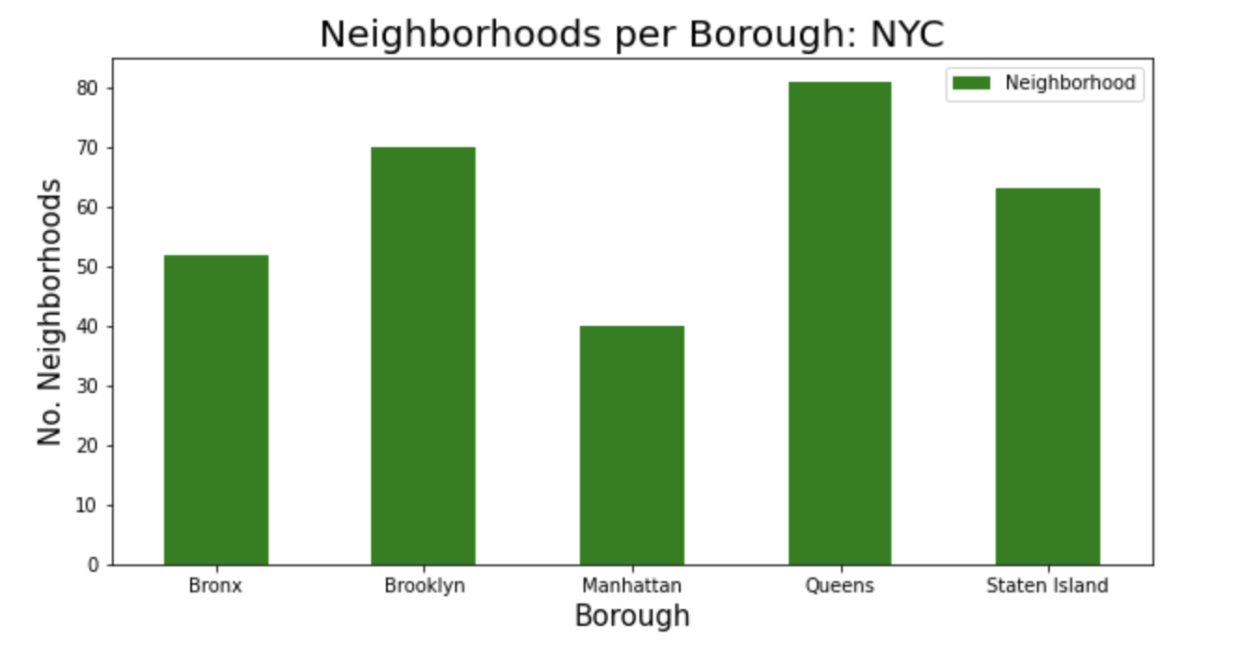
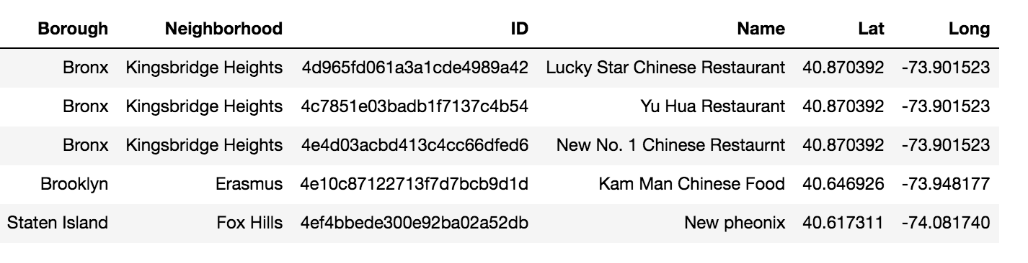
Neighborhoods per Borough

Slide 5

Chinese Restaurant in NYC

Slide 6
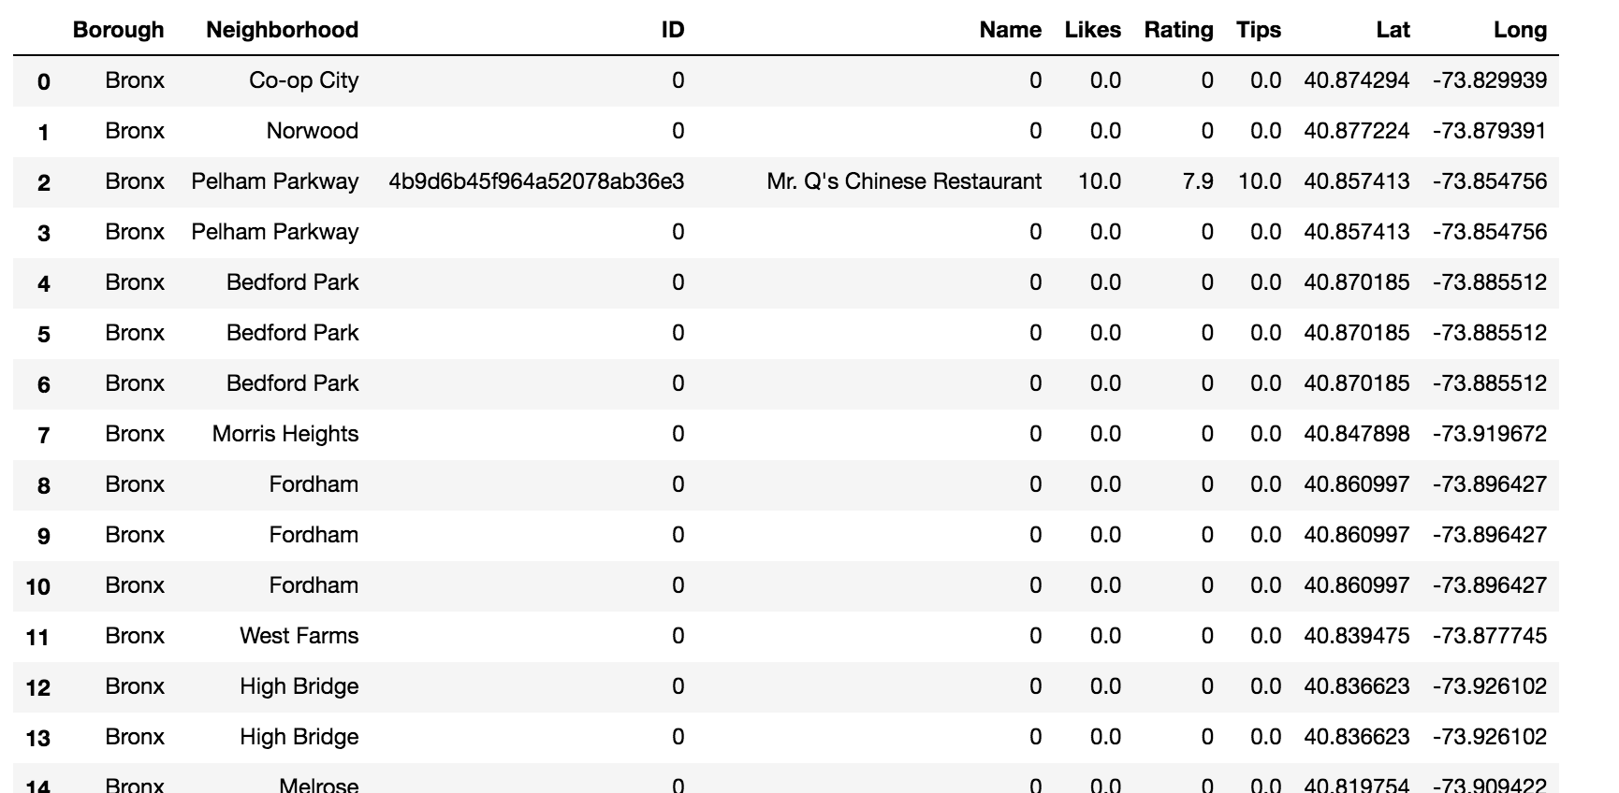
Statistics

Slide 7
Conclusion
In order to open the restaurant, the choosing of location is most important, choose the location that still there is no Chinese restaurant in radius 1 Km
The Rating, Comments and Likes can be consider as statistics of competitors

